Slide 1
Computer Organization & Architecture
“Computer Organization and Embedded Systems”
Carl Hamacher, Zvonko Vranesic, Safwat Zaky, Naraig Manjikian

Slide 2
Fundamentals
Instruction:
Fetched from memory location pointed by program counter PC
Put in the Instruction Register IR
IR <- [[PC]]
PC <- [PC] + 4

Slide 3
Operations
Can be carried out by performing one or more of the following actions:
Read contents of a memory location and load into a processor register
Read data from one or more processor registers
Perform arithmetic or logic operation and place result into a processor register
Store data from a processor register into a memory location

Slide 4
Main H/W Components of Processor
Register File
Instruction Address Generator
Processor Memory Interface
PC
IR
ALU
Control Circuitry

Slide 5
Register File
Register ﬁle are storage locations:
Organized to form processor’s general-purpose registers
Registers comprise edge-triggered ﬂip-ﬂops
Into which new data are loaded at the active edge of the clock

Slide 6
Execution
During execution:
Contents of specified registers are sent to arithmetic and logic unit (ALU)
ALU performs the required computation
Data are processed by combinational circuits and results placed into a register
Results of computation are stored in a register in register ﬁle
A clock signal is used to control timing of data transfers

Slide 7
Instruction execution
LOAD instruction
Ex. Load R5, X(R7)
Fetch the instruction from the memory
Increment the program counter
Decode instruction to determine operation to be performed
Read register R7
Add immediate value X to the contents of R7
Use sum X + [R7] as effective address of source operand
Read the contents of that location in the memory
Load data received from memory into destination register, R5

Slide 8
Multi-stage structure
Operations can often be broken down into several simpler steps
Each step is performed by a subcircuit of the original circuit
Subcircuits can be cascaded into a multistage structure
If n stages are used, operation will be completed in n clock cycles
Since subcircuits are smaller, they can complete operation in less time, and hence a shorter clock period can be used
Key advantage of the multi-stage structure is that it is suitable for pipelined operation
Particularly useful for implementing processors that have a RISC-style instruction set

Slide 9
Multi-stage structure
Assuming processor has ﬁve hardware stages, execution of each instruction is divided into ﬁve steps:
Fetch instruction and increment the program counter
Decode instruction and read source operands
Compute
Access memory for read/write
Store result in register file

Slide 10
Load instruction
LOAD R5, X(R7)
Fetch instruction and increment the program counter
Decode instruction and read contents of register R7
Compute the effective address
Read the memory source operand
Load the operand into the destination register, R5

Slide 11
Arithmetic/Logical instruction
Ex. Add R3, R4, R5
Fetch the instruction and increment the program counter
Decode instruction and read contents of source registers R4 and R5
Compute the sum [R4] + [R5]
Load the result into the destination register, R3

Slide 12
Arithmetic/Logical instruction
It is advantageous to use same multistage processing hardware for as many instructions as possible
Can be achieved if all instructions are made to be executed in the same number of steps
To this end, Add instruction should be extended to ﬁve steps

Slide 13
Arithmetic/Logical instruction
Add instruction would then be performed as follows:
Fetch the instruction and increment the program counter
Decode the instruction and read registers R4 and R5
Compute the sum [R4] + [R5]
No action
Load the result into the destination register, R3

Slide 14
Arithmetic/Logical instruction
Ex. Add R3, R4, #1000
Fetch the instruction and increment the program counter
Decode the instruction and read register R4
Compute the sum [R4] + 1000
No action
Load the result into the destination register, R3

Slide 15
Store instruction
Store R6, X(R8)
Fetch instruction and increment program counter
Decode instruction and read registers R6 and R8
Compute the effective address X + [R8]
Store contents of register R6 into memory location X + [R8]
No action

Slide 16
Register file
A small and fast memory block
Consists of an array of storage elements
Access circuitry enables data to be read from or written into any register
 | Input data
Address A | C Register file A B
 |  | Address C
Address B
 | Output data

Slide 17
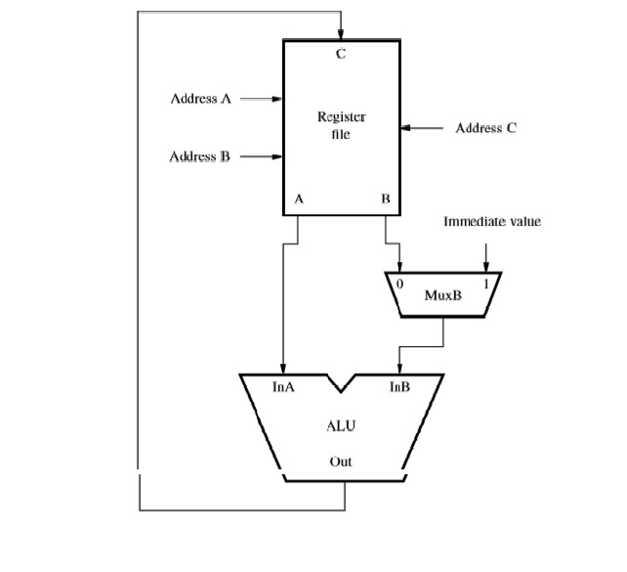
Computation

Slide 18
5-stage organization
Instruction fetch
Stage 1
Source registers
Stage 2
ALU
Stage 3
Memory access
Stage 4
Destination registers
Stage 5

Slide 19
5-stage organization
Actions in each stage are completed in one clock cycle
Instruction fetched in step 1 by stage 1 is placed in IR
It is decoded, and its source registers are read in step 2
Information in IR is used to generate control signals for all subsequent steps
IR must continue to hold instruction until its execution is completed
It is necessary to insert registers between stages
Inter-stage registers hold the results produced in one stage
Can be used as inputs to the next stage during the next clock cycle

Slide 20
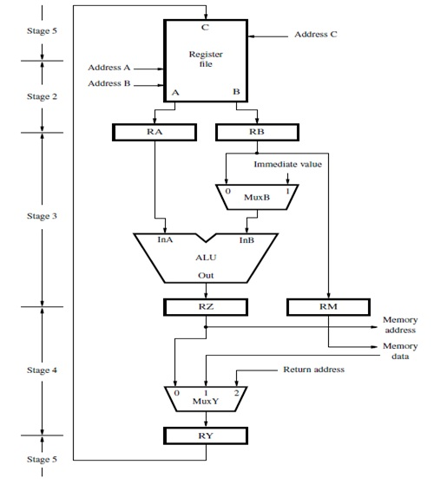
Datapath

